Slide 1
Article Finder
An open Source research support tool

Slide 2
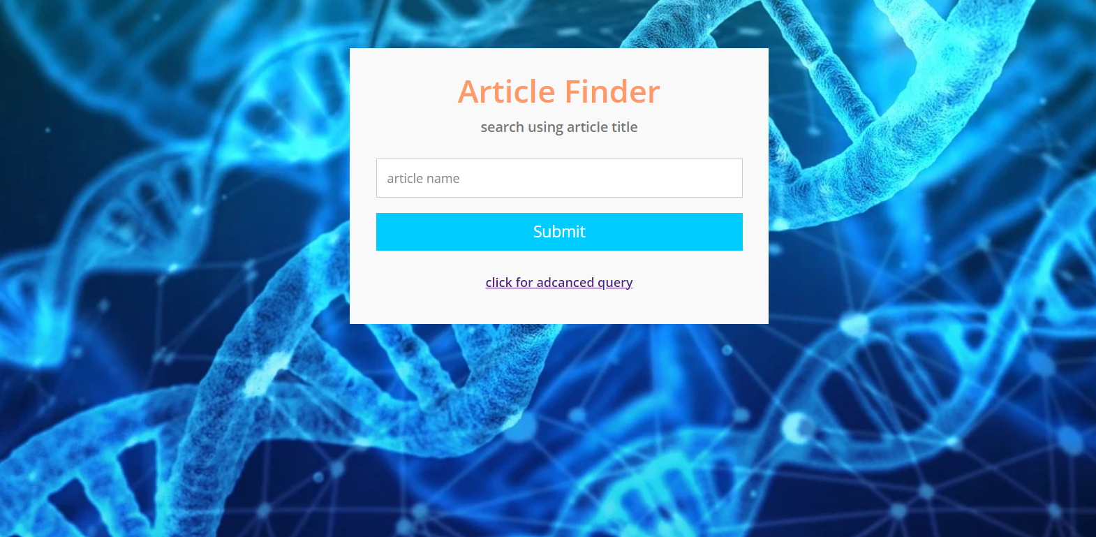
Enter the research paper name

Slide 3
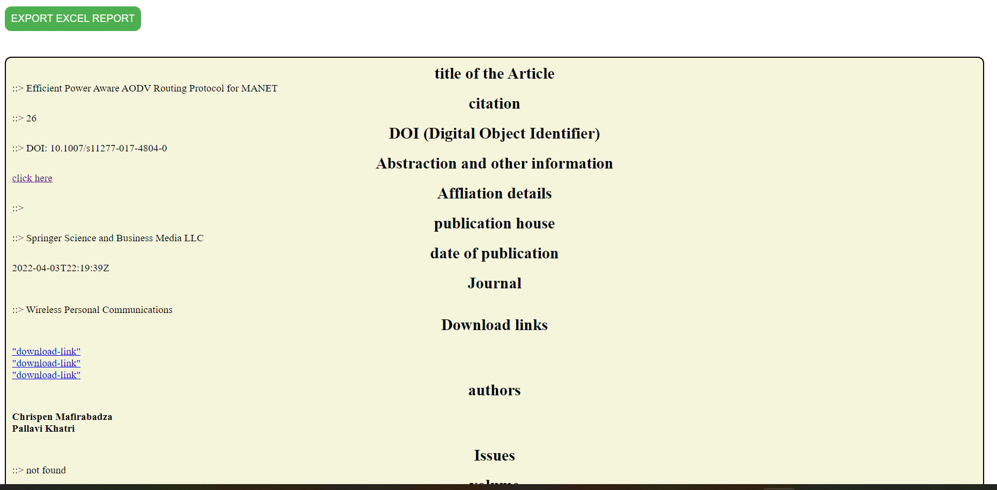
RESULT

Slide 4
Searching with advanced query

Slide 5
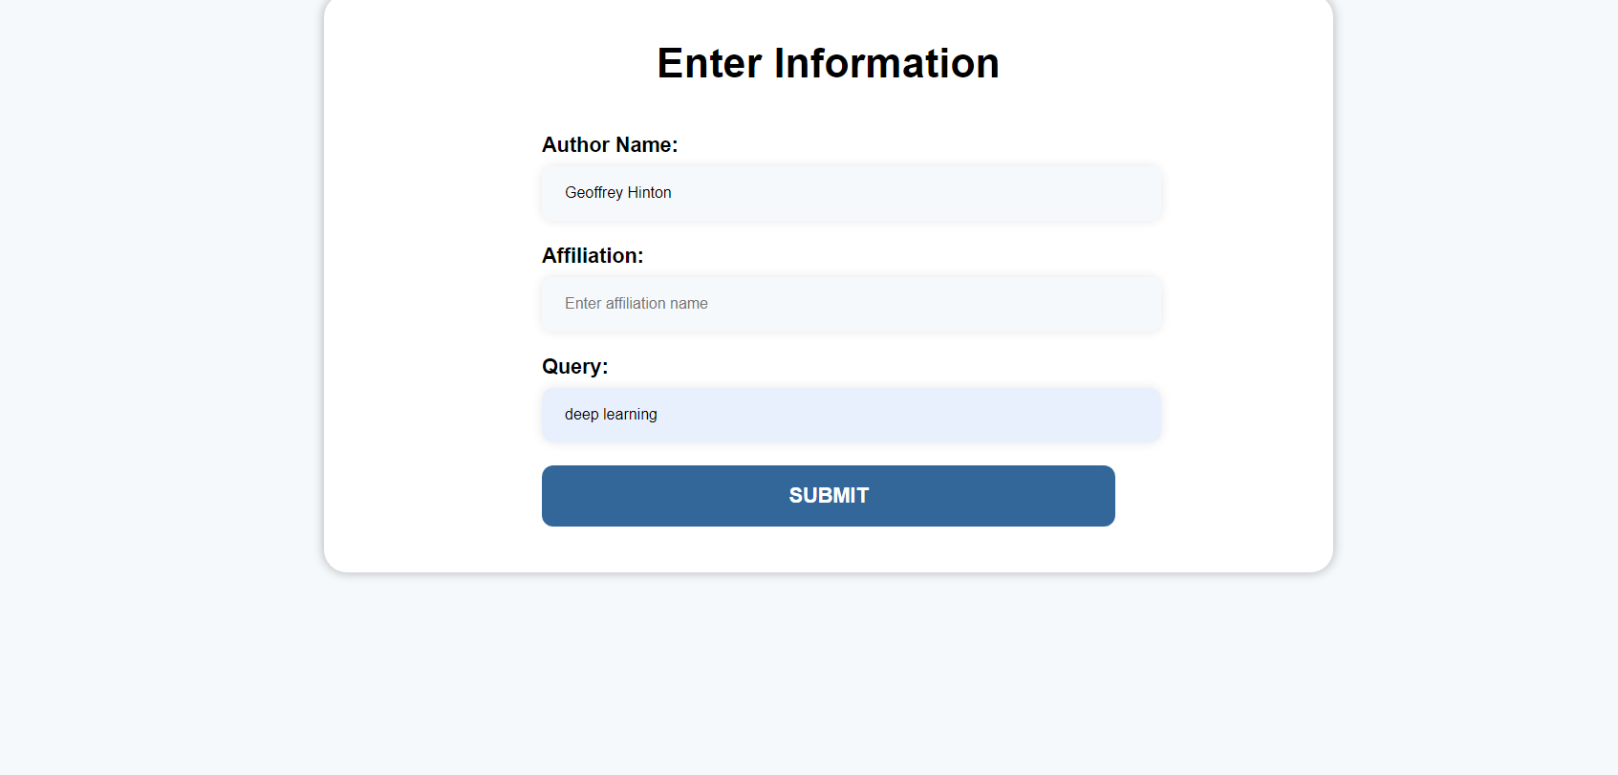
Enter Info

Slide 6
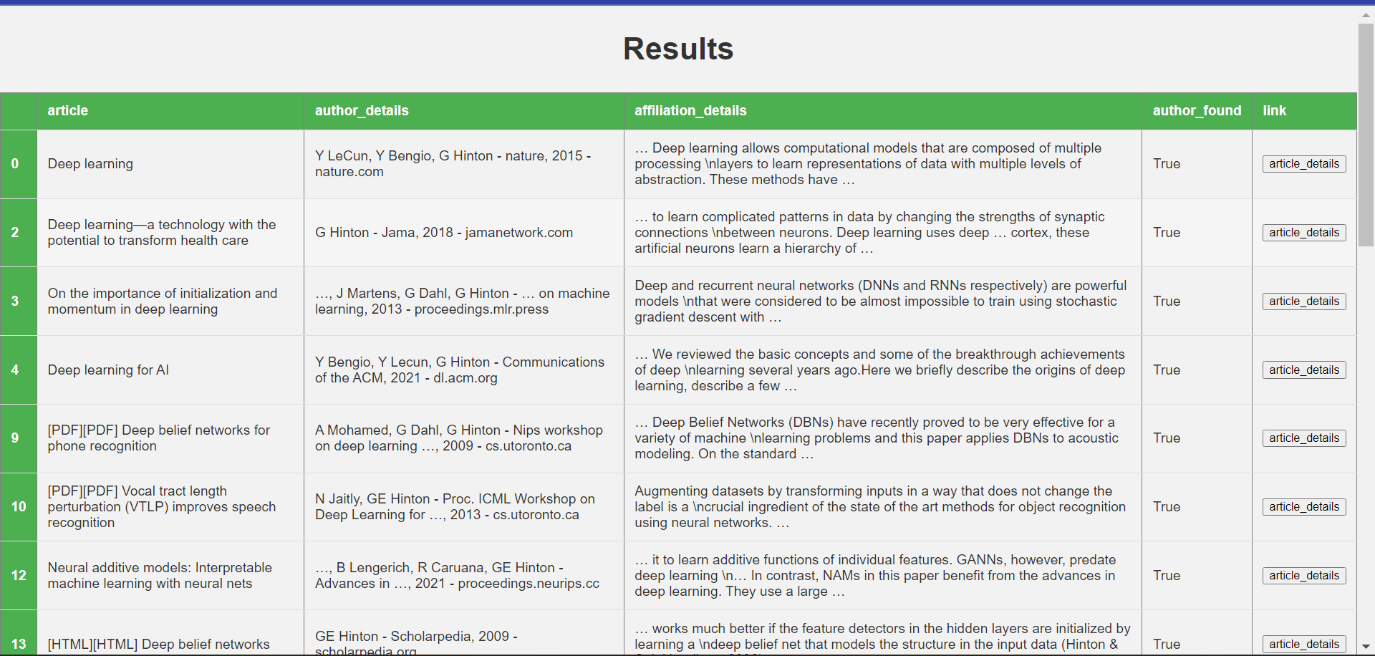

Slide 7
Article Finder is an open-source article finder tool that provides information on research articles, including the DOI, title, author, citation, abstract, and date of publication. The tool extracts information from Library Genesis and Google Scholar using web scraping techniques. It can be used to easily find and retrieve relevant articles for research or academic purposes. The tool is written in Python and can be used on any platform that supports Python

